Slide 1
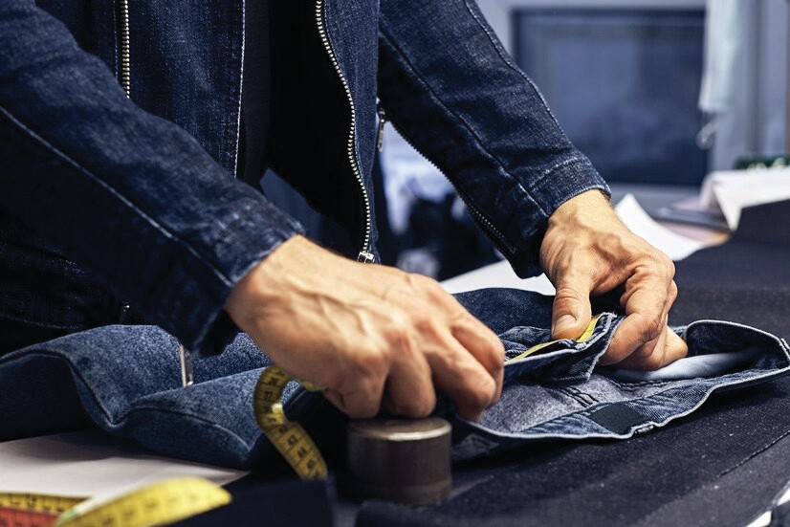
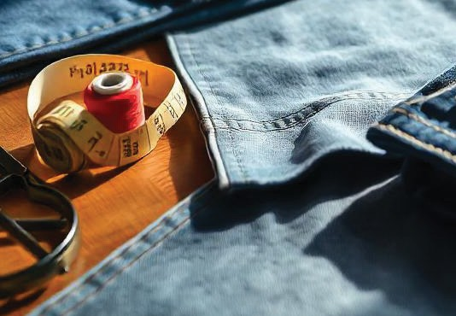
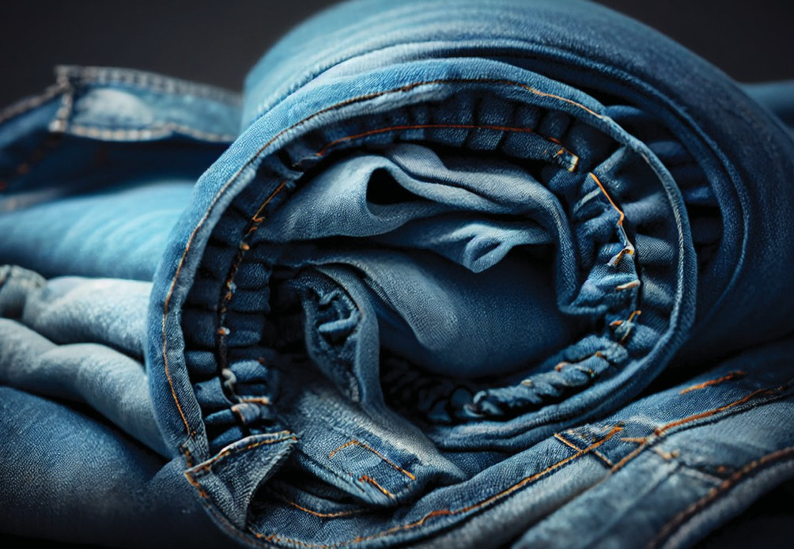

Slide 2
TABLE OF CONTENTS
01
03
02
ABOUT US
&
WHO WE ARE
OVERVIEW
OUR LEGACY
08
10
09
SUSTAINABILITY
CERTIFICATIONS
SUSTAINABLE FABRICS

Slide 3
04
06
05
07
OUR VISION
&
OUR MISSION
CUSTOMER PORTFOLIO
CORE VALUES
R&D TEAM
12
11
13
2024 ACHIEVEMENTS
&
2025 GOALS
OUR PRODUCTS
MARKET SEGMENTS

Slide 4
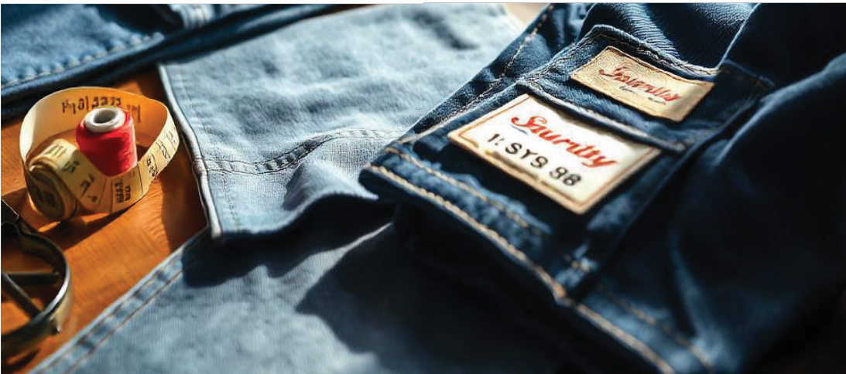
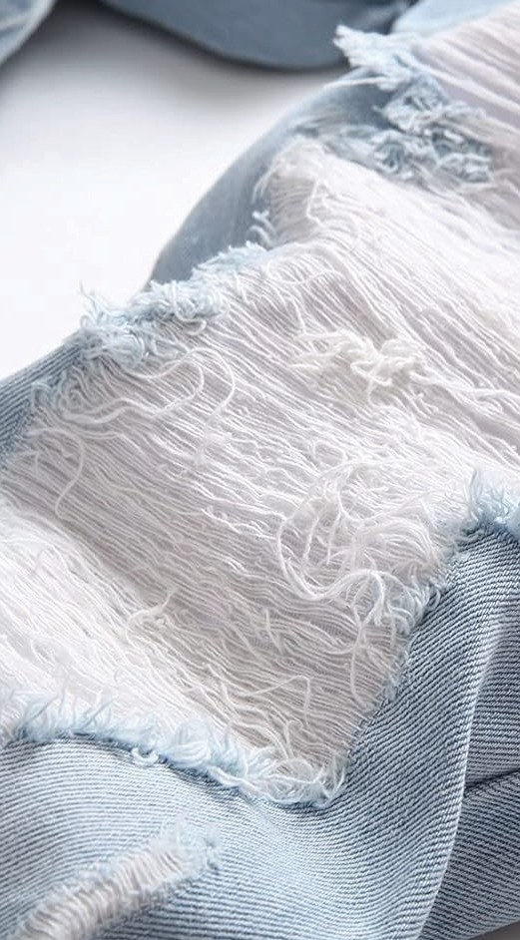
ABOUT US
WHO WE ARE
Founded in 2010, we are a leading jeans manufacturer with 14+ years of experience and a team of over 1,500 skilled employees.
Our high-quality, sustainable denim production boasts an annual capacity of 5 million units.

Slide 5
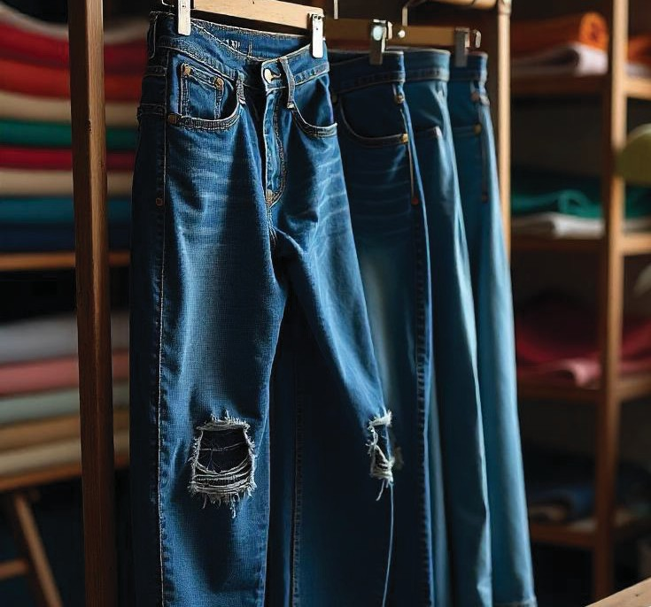
OUR LEGACY
Since our inception, we have become a prominent player in the denim industry, known for exceeding expectations in quality, design, and delivery.
Emphasizing innovation and sustainability, we are shaping the future of denim manufacturing.

Slide 6
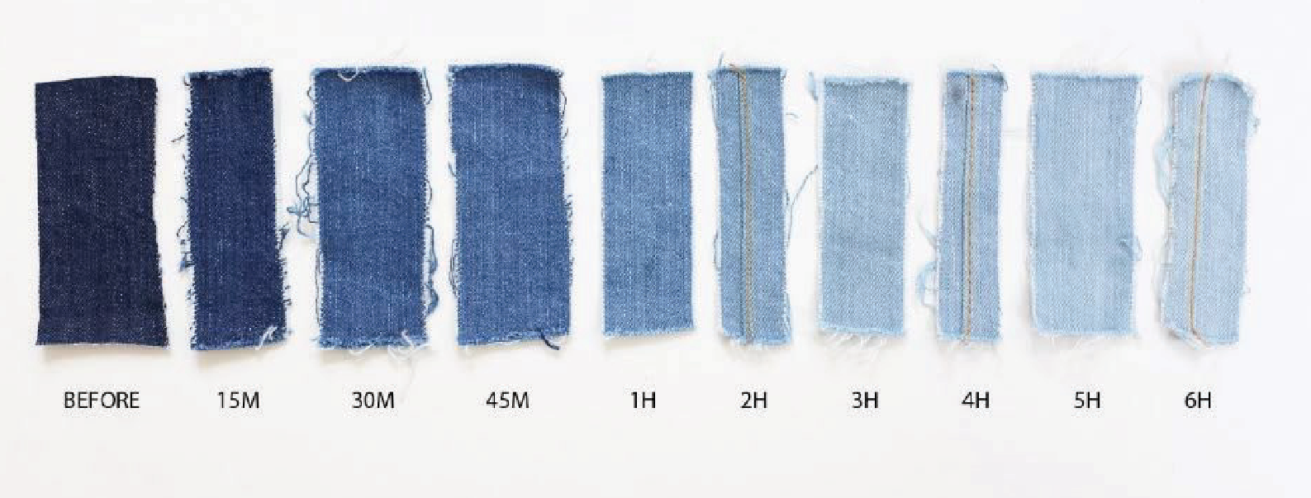
5,000,000 UNITS
OVERVIEW
Annual Production Capacity
Workforce
1,500⁺ EMPLOYEES

Slide 7
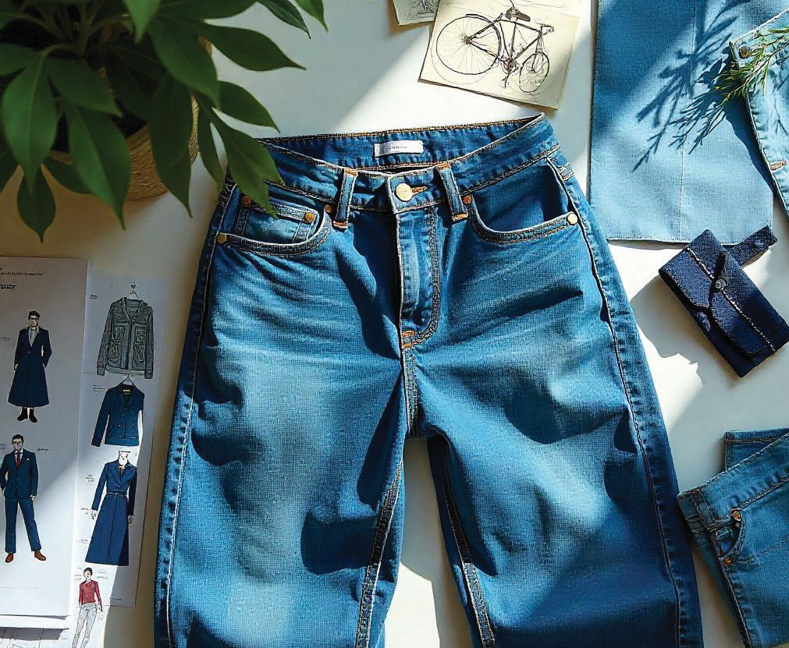
OUR VISION
To provide competitive products & services, focusing on quality, price, & timely delivery, while prioritizing sustainability.
OUR MISSION
To inspire the industry by adopting eco-friendly manufacturing processes and utilizing sustainable materials.

Slide 8
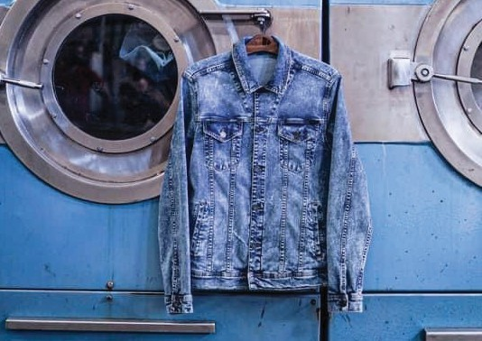
CORE VALUES
Customer Satisfaction Social Responsibility
High-Performance Standards Respect for People
Women Empowerment Integrity
Being part of a developing economy, we consider it our duty and primary responsibility to contribute to sustainable growth and community development.

Slide 9











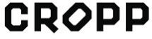
CUSTOMER PORTFOLIO

Slide 10
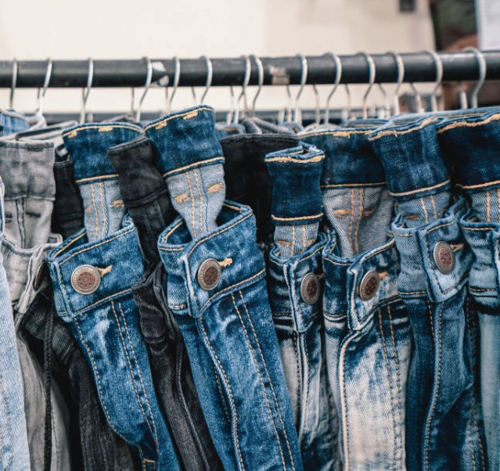
R&D TEAM
PRODUCT DEVELOPMENT CENTRE
Our Product Development Centre drives innovation, staying ahead of market trends to forecast future fashion demands

Slide 11
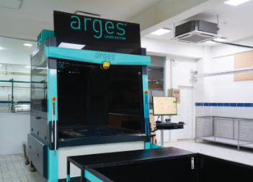
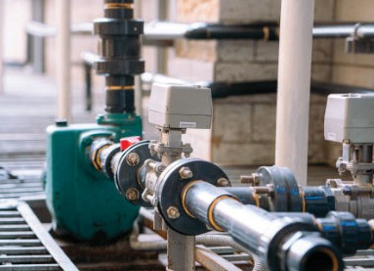
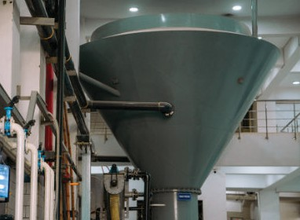
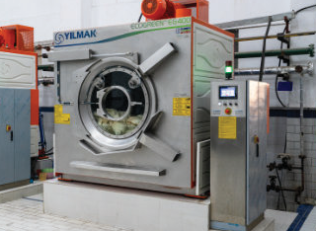
SUSTAINABILITY
We are deeply committed to sustainability and prioritize eco-f riendly practices throughout every stage of our production process, f rom sourcing materials to final garment creation.
Water Recycling & Technologies
Our factories use water recycling plants and ozone machines in the washing process. Laser machines are employed to create design effects on garments. We plan to adopt renewable energy.
Sustainable Fabrics
We partner with sustainable fabric mills in Pakistan, using
innovative fibers in our denim.
Washing & Stitching
Eco-friendly washing and precise stitching ensure quality and durability. Our front-loading washing and drying machines enhance efficiency.
Water Saving
The ETP Plant (Water Saving Plant) efficiently conserves up
to 60% of water, which can be effectively utilized. The
integrated conveyor system further contributes to reducing
waste and enhancing efficiency by air-drying 75% of the
garment before being placed in the dryer.

Slide 12






SUSTAINABLE FABRICS
100% BCICotton (BettercottonInitiative)
Post consumer waste warn
Organic cotton
Wood based fibers(Lenzing)
Alternative Fibers
Industrial waste yarns

Slide 13









CERTIFICATIONS

Slide 14
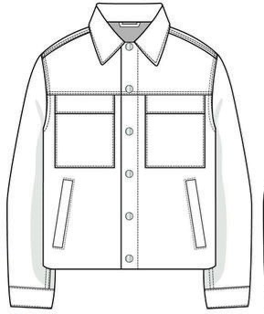
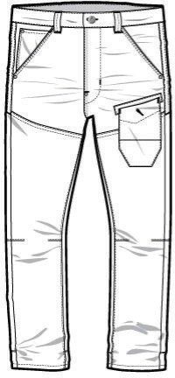
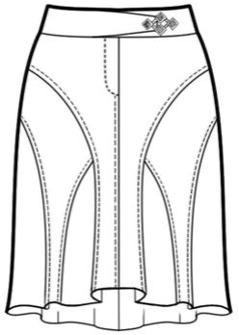
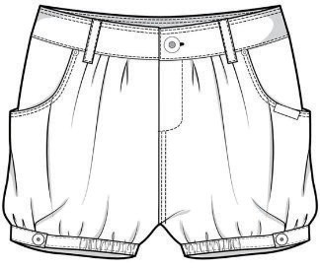
OUR PRODUCTS

Slide 15



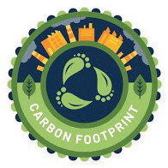
2024 ACHIEVEMENTS
FAIR TRADE CERTIFICATION
SOLAR ENERGY
WWF GREEN OFFICE
2025 GOALS
Circular Economy
INTEGRATE SMART MANUFACTURING.
IMPLEMENT CIRCULAR ECONOMY PRACTICES.
ACHIEVE SIGNIFICANT REDUCTIONS IN CARBON FOOTPRINT.

Slide 16



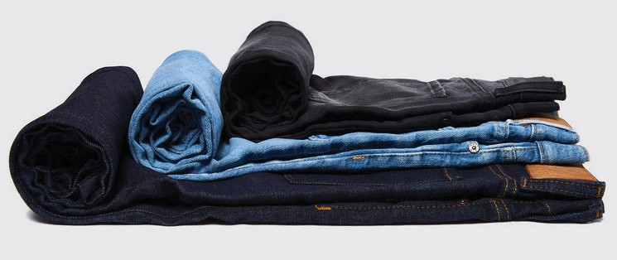
MARKET SEGMENTS
US Market: 20%
Europe Market: 60%
Middle East: 20%
20%
20%
60%

Slide 17
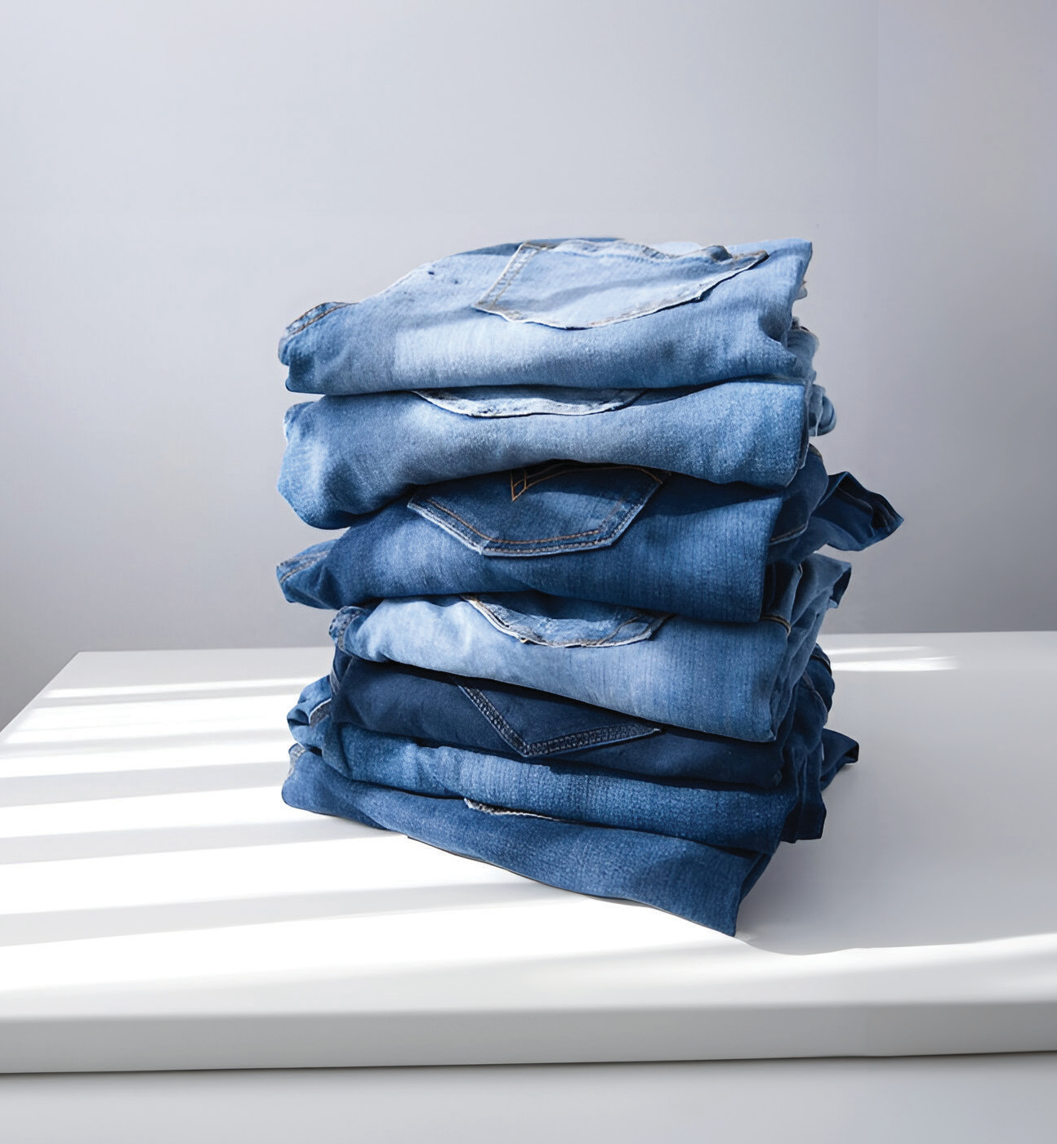
Website: www.denimcrafts.com Phone: +92 21 369 63175-6
Factory Address: Plot No 8/12-A, Sector 12-C North Karachi Industrial Area, Karachi, Pakistan

